Slide 1
OpenFabrics and UCX
Performance on the ARCHER2 HPE Cray EX system
Michael Bareford, William Lucas, Andy Turner
EPCC, The University of Edinburgh
www.archer2.ac.uk

Slide 2

Reusing this material
This work is licensed under a Creative Commons Attribution-NonCommercial-ShareAlike 4.0 International License.
https://creativecommons.org/licenses/by-nc-sa/4.0/
This means you are free to copy and redistribute the material and adapt and build on the material under the following terms: You must give appropriate credit, provide a link to the license and indicate if changes were made. If you adapt or build on the material you must distribute your work under the same license as the original.
Note that this presentation contains images owned by others. Please seek their permission before reusing these images.

Slide 3




Partners

Slide 4
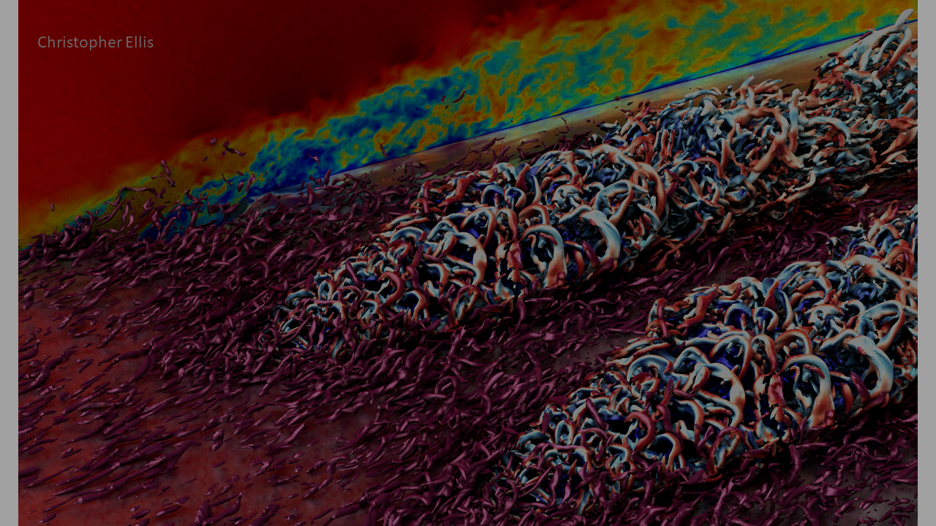
ARCHER2 Overview

Slide 5
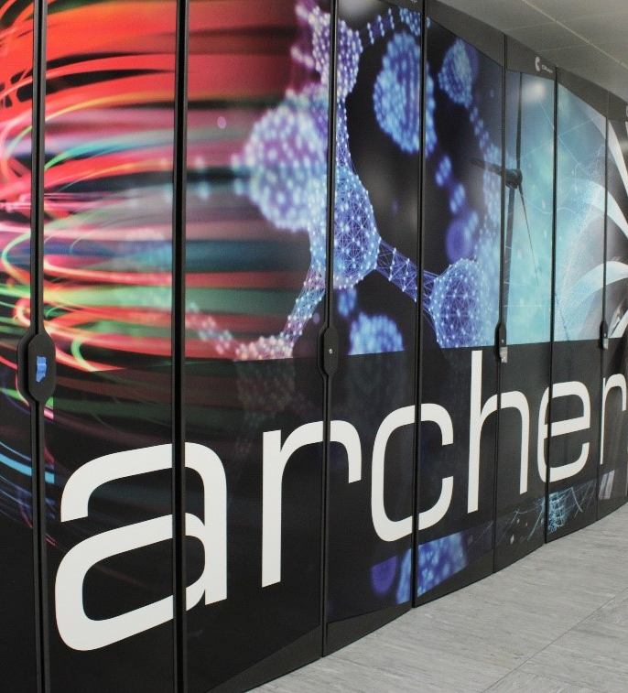
ARCHER2 system
HPE Cray EX Supercomputer
Hosted at EPCC, The University of Edinburgh
5,860 compute nodes (750,080 CPU compute cores)
HPE Cray Slingshot interconnect
Compute nodes:
Dual socket AMD EPYCTM 7742 (Rome), 64c, 2.25 GHz
256 GIB / 512 GiB memory per node
Two 100 Gbps Slingshot interfaces per node
3x ClusterStor L300 Lustre file systems, each 3.6 PB
1 PB ClusterStor E1000F solid state storage
Not available at start of service
Will be available to users via Slurm BB directives
4x NetApp FAS8200A file systems, 1 PB total

Slide 6
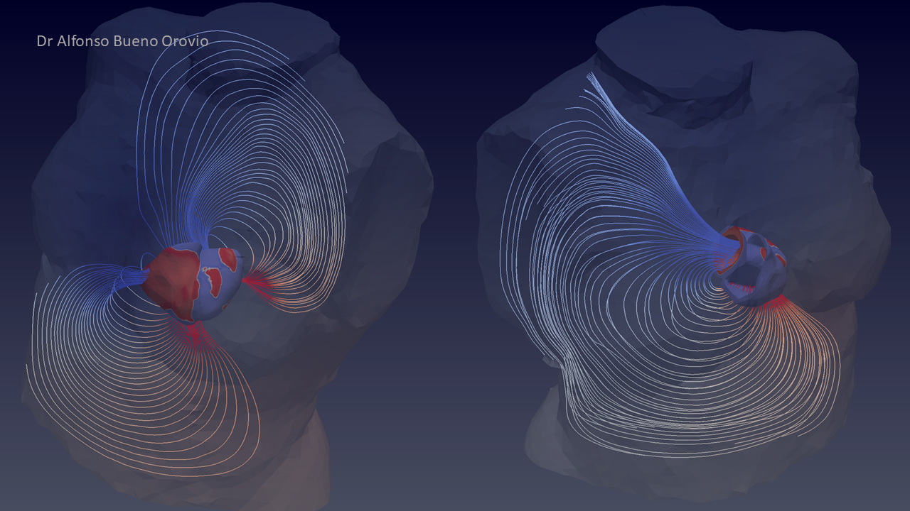
Benchmark details

Slide 7
Build environment

Slide 8

Results and analysis

Slide 9

Results

Slide 10
Next steps and summary

Slide 11
Next steps

Slide 12
Summary

